Slide 1
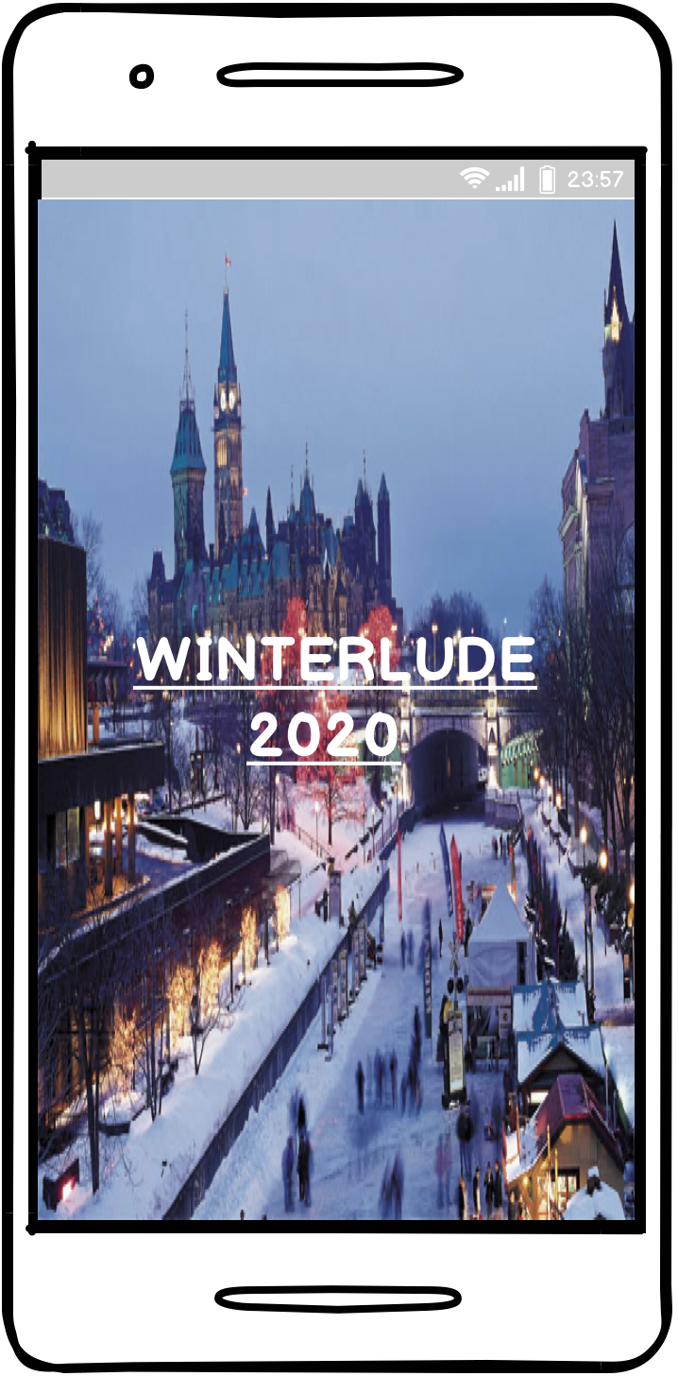
Winterlude Mobile Application Concept Design
Minal Patel

Slide 2
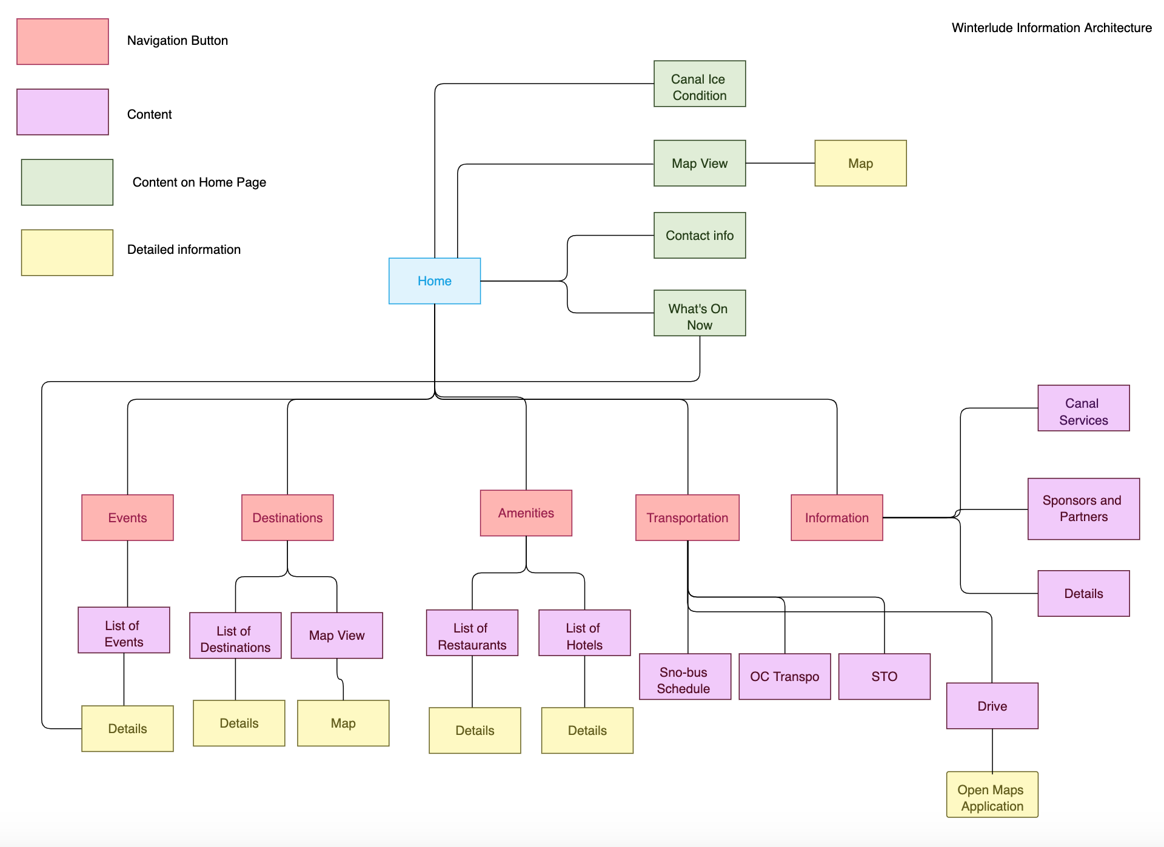
Information Architecture

Slide 3
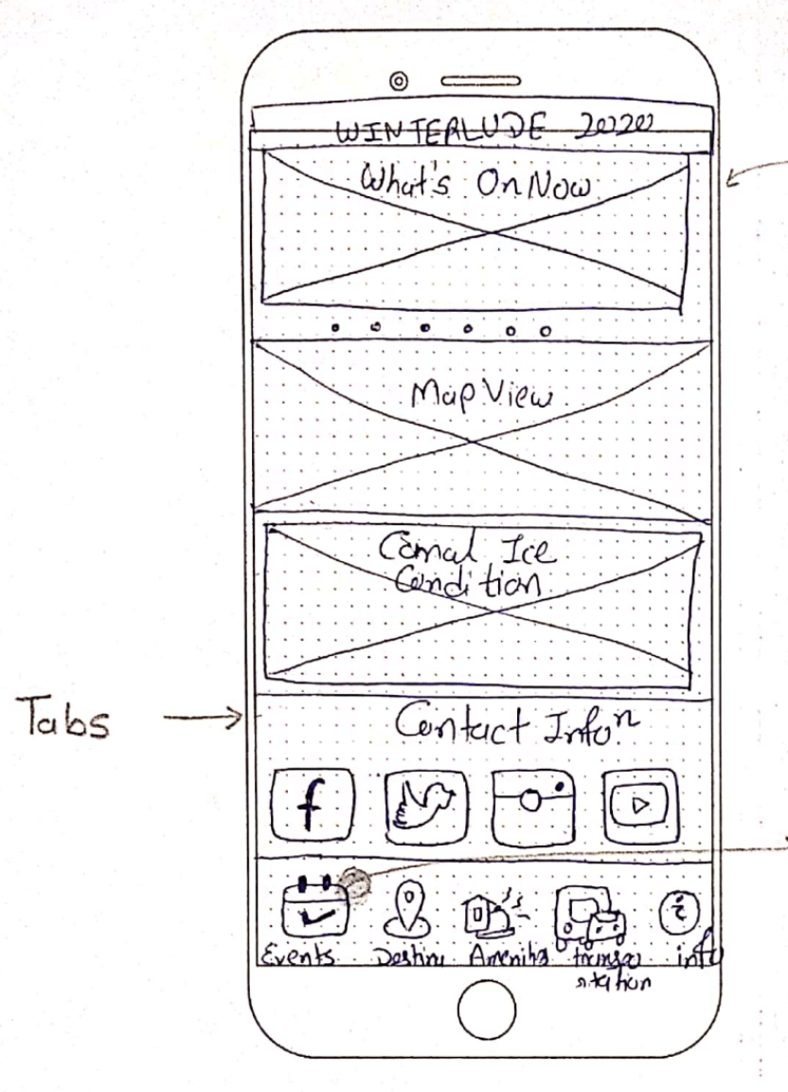
Home/Landing Screen!
Contains:
Carousel of events which are going on Now
Map View of Destinations and Events
Canal Ice Condition
And Tab View for Events, Destinations, Amenities, Transformation, More info

Slide 4
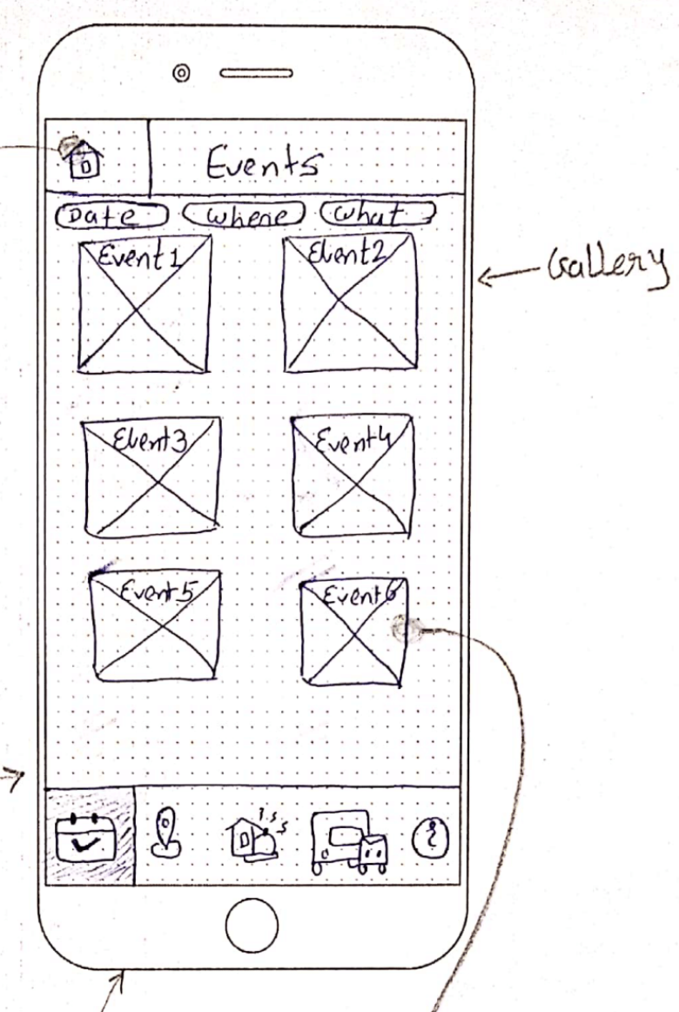
Section Screen (Events)!
Shows filter for Events
By Date
Where
What kind
Filtered Events
Gallery Navigation Model of each events(Picture and Title)

Slide 5
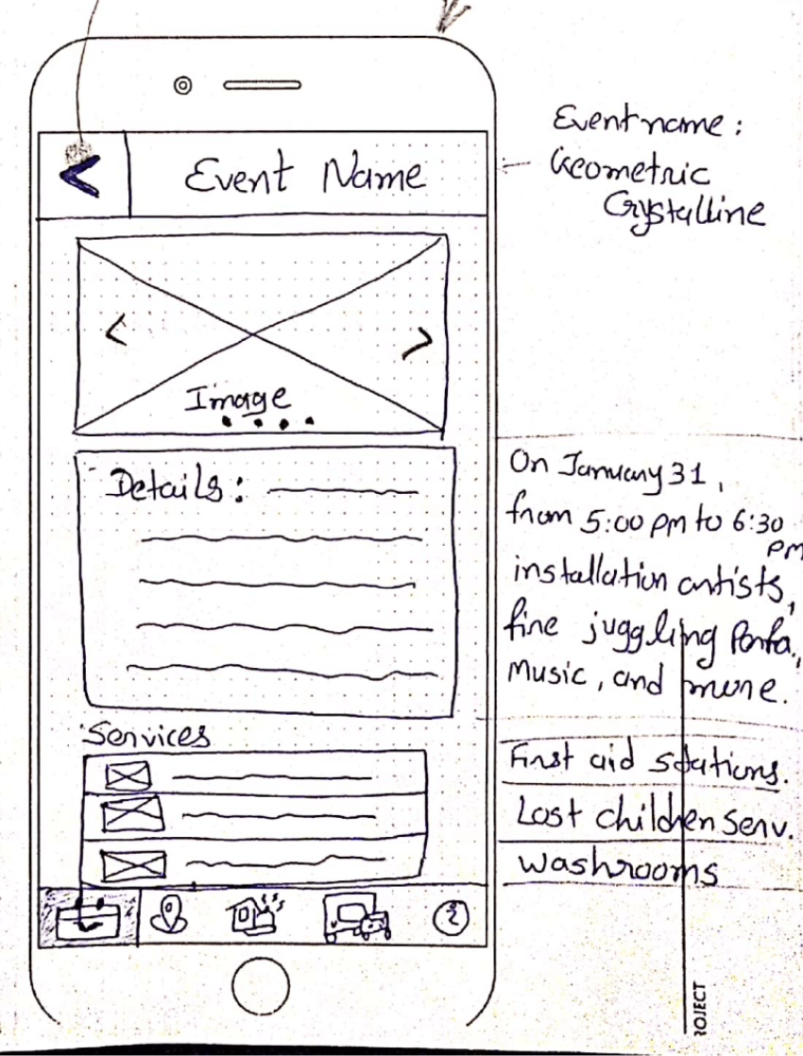
Sub Screen (Particular Event)!
Event Detail
Carousel of event images
Details (Where/At What Time/Description)
Services(List View)

Slide 6

Concept Design Demo

Slide 7
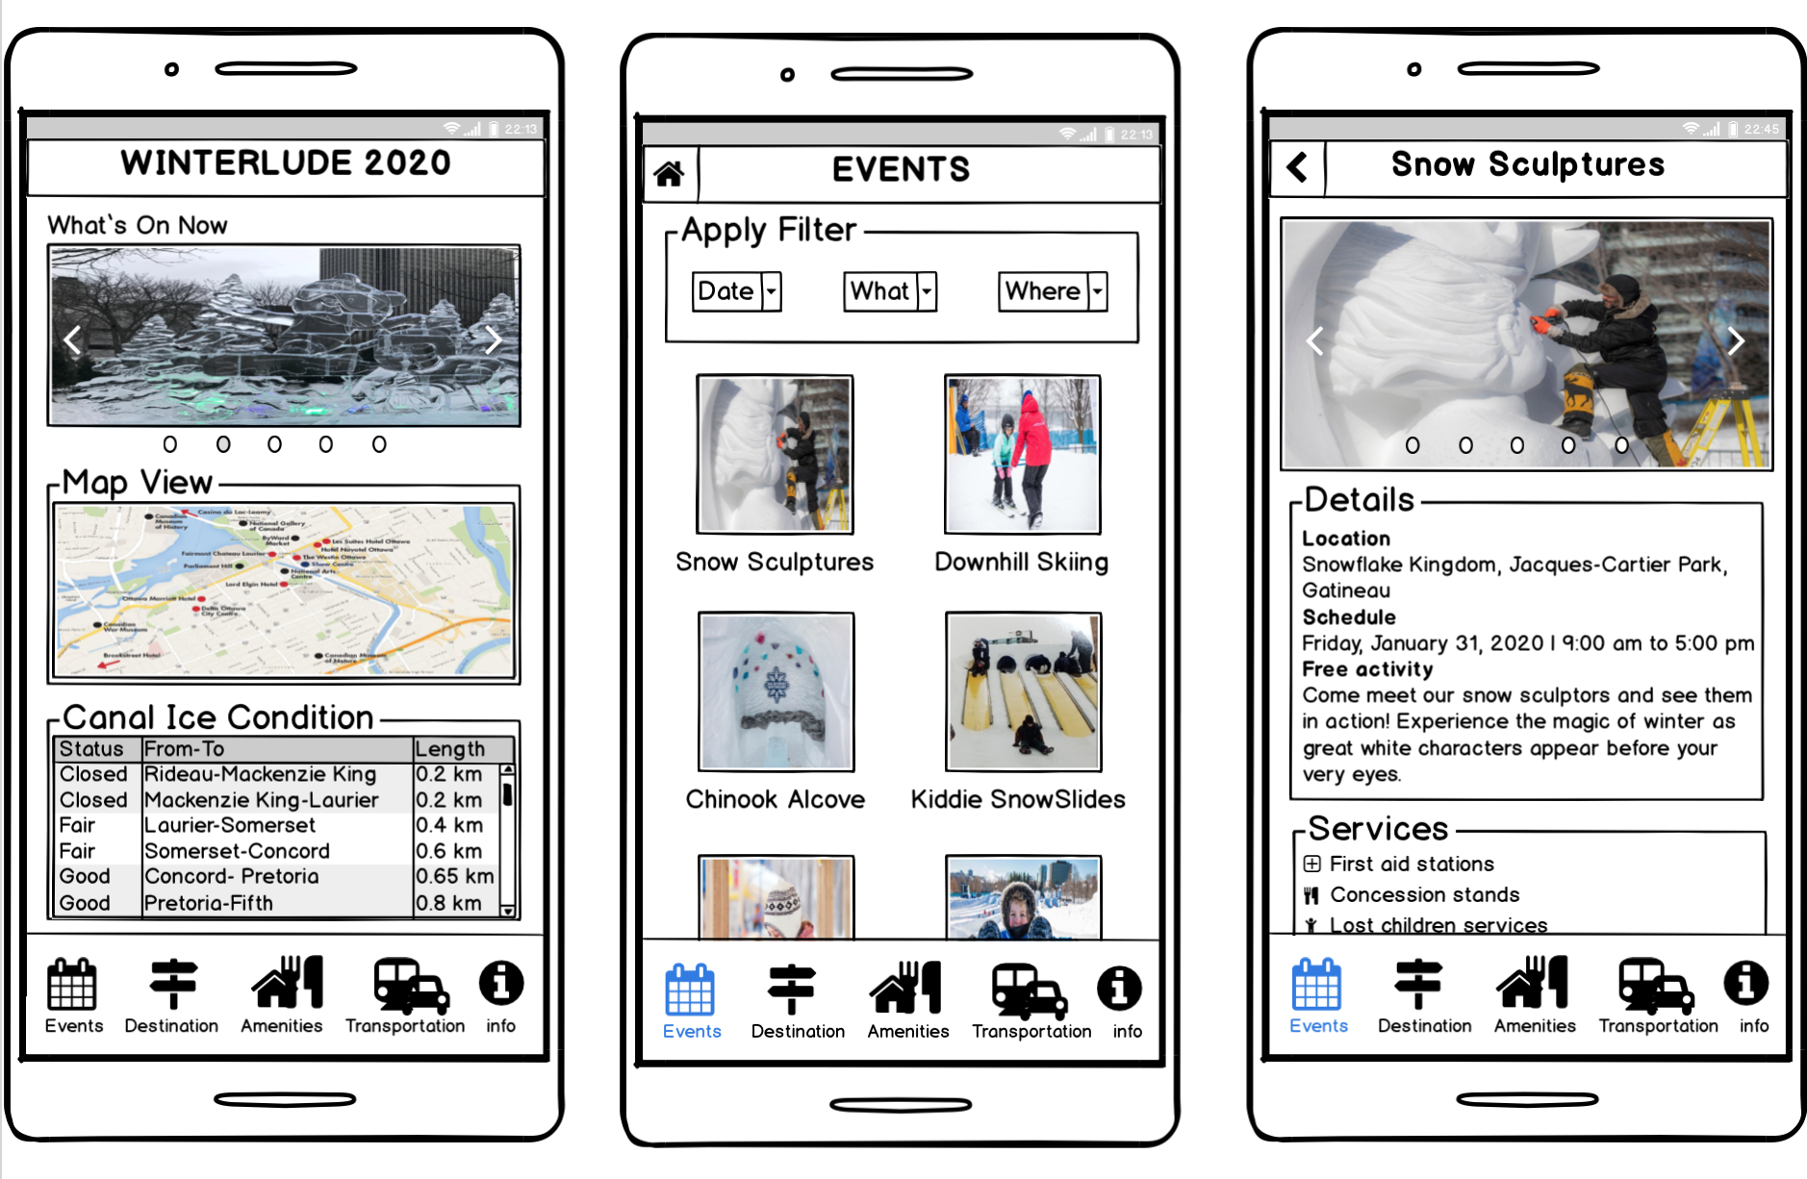

Slide 8
Questions?

Slide 9
Feedback

